Slide 1
ME3451
THERMAL ENGINEERING
Presented by
PANDIAN.K
ASSISTANT PROFESSOR
DEPARTMENT OF MECHANICAL ENGINEERING

Slide 2
UNIT IV
INTERNAL COMBUSTION ENGINES-FEATURES AND COMBUSTION

Slide 3
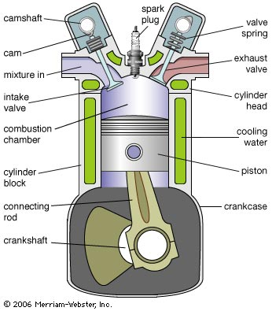
Construction and Working of I.C. Engine

Slide 4
Internal Combustion Engines
types of heat engines
steam engines
external combustion
turbines
Stirling engine
Otto engine
internal combustion
Diesel engine
Vankel engine

Slide 5
Internal Combustion Engine Basics
air

Slide 6
Internal Combustion Engine Basics
air
pressure
pressure =
force
area
force =
pressure x
area

Slide 7
Internal Combustion Engine Basics
air + fuel
pressure
pressure =
force
area
force =
pressure x
area

Slide 8


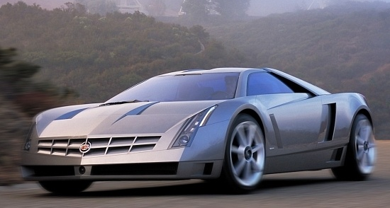
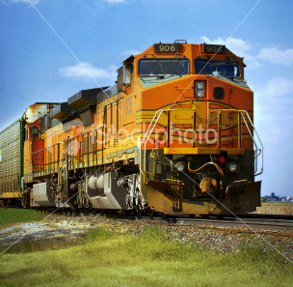
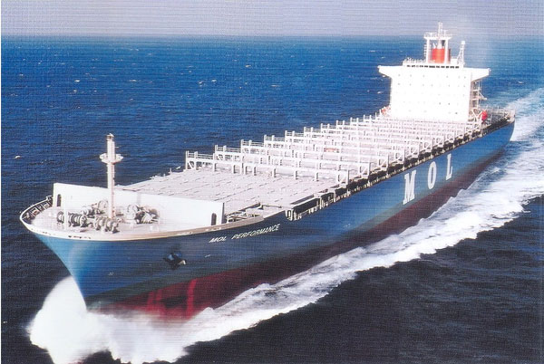
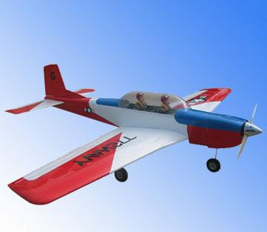
Internal Combustion Engines
The internal combustion engine is an engine in which the combustion of fuel-oxidizer mixture occurs in a confined space
applied in:
automotive
rail transportation
power generation
ships
aviation
garden appliances

Slide 9
Combustion Engine Definiton
Combustion engines are machines that deliver mechanical work through a linked thermal and combustion process: mechanical work is obtained from the chemical bound energy of the fuel (fuel energy) through combustion by means of thermal energy.
In the reciprocating engines the working chamber has rigid walls: the stroke of one of the these walls (pistons) provides a variable volume.
The work output is gained from the gas pressure

Slide 10
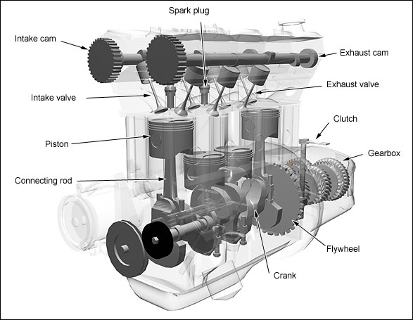
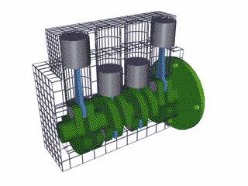
Engines
Configuration
Engines: The cylinders are arranged in a line, in a single bank.

Slide 11
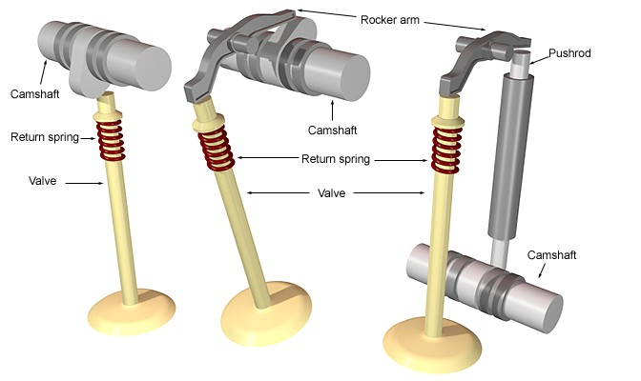
Engines
Parts
Valves: Minimum
Two Valves pre Cylinder
Exhaust Valve lets the exhaust gases escape the combustion
Chamber. (Diameter is smaller then Intake valve)
Intake Valve lets the air or air fuel mixture to enter the
combustion chamber. (Diameter is larger than the exhaust valve)

Slide 12
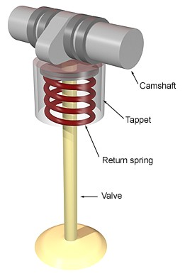
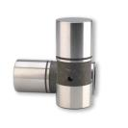
Engines
Valve Springs: Keeps the valves
Closed.
Valve Lifters: Rides the cam lobe
and helps in opening the valves.

Slide 13
Engines
Different arrangement of valve and camshaft.

Slide 14
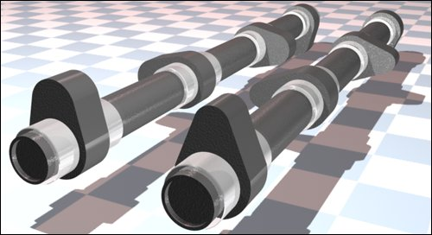
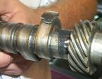
Engines
Cam Shaft: The shaft that has intake and
Exhaust cams for operating the valves.
Cam Lobe: Changes rotary motion
into reciprocating motion.

Slide 15
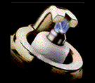
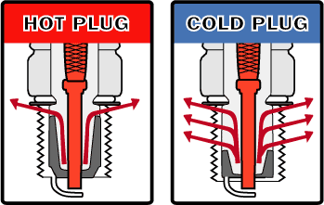
Engines
Spark Plug
It provides the means of ignition when
the gasoline engine’s piston is at the end
of compression stroke, close to
Top Dead Center(TDC)
The difference between a
"hot" and a "cold" spark
plug is that the ceramic tip
is longer on the
hotter plug.

Slide 16
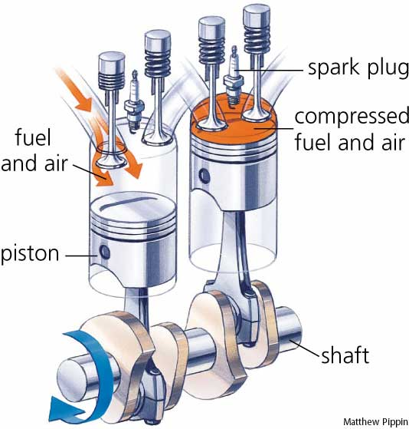
Engines
Piston
A movable part fitted into a
cylinder, which can receive and
transmit power.
Through connecting rod, forces
the crank shaft to rotate.

Slide 17
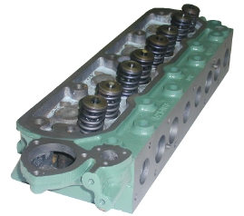
Engines
Cylinder head
Part that covers and encloses the
Cylinder.
It contains cooling fins or water jackets
and the valves.
Some engines contains the cam shaft
in the cylinder head.

Slide 18

Engines
Engine Block
Foundation of the engine and
contains pistons, crank shaft,
cylinders, timing sprockets and
sometimes the cam shaft.

Slide 19
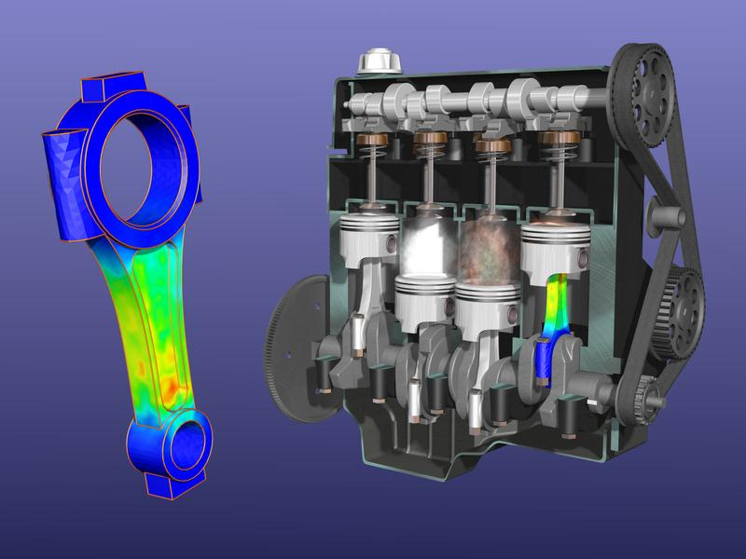
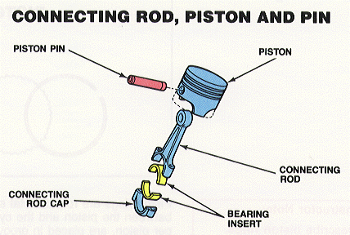
Engines
Connecting (conn.) Rod
Attaches piston (wrist-pin)
to the crank shaft (conn. rod
caps).

Slide 20
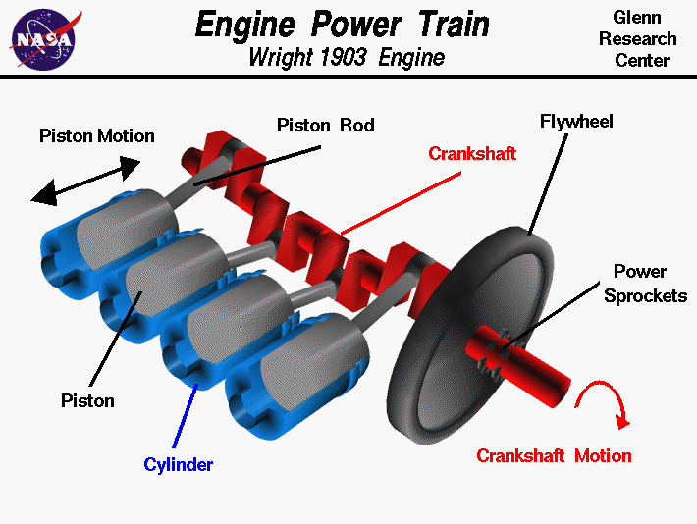
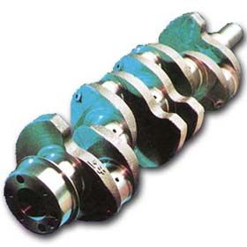
Engines
Crank Shaft
Converts up and down or
reciprocating motion into
circular or rotary motion.
DAMPNER PULLEY
Controls Vibration

Slide 21
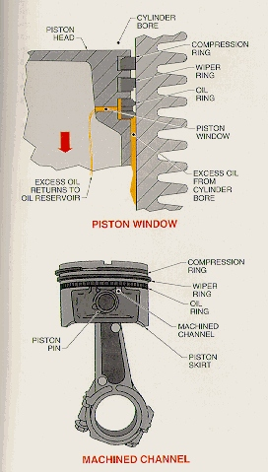
Engines
Piston Rings
Four stroke: Three rings
Top two are compression rings (sealing
the compression pressure in the cylinder)
and the third is an oil ring (scrapes
excessive oil from the cylinder walls)
Two Stroke: Two Rings
Both the rings are Compression rings.

Slide 22
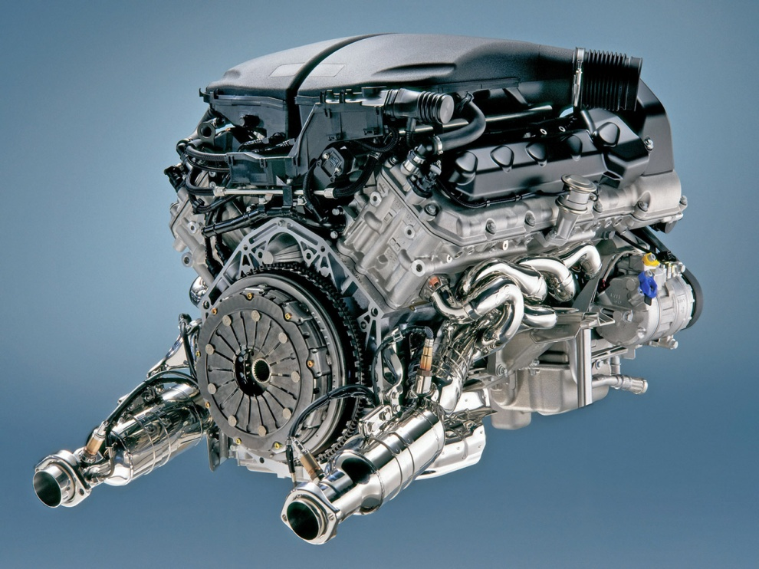
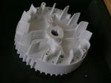
Engines
Flywheel
Attached to the crankshaft
Reduces vibration
Cools the engine (air cooled)
Used during initial start-up
Transfers power from engine to
drivetrain

Slide 23
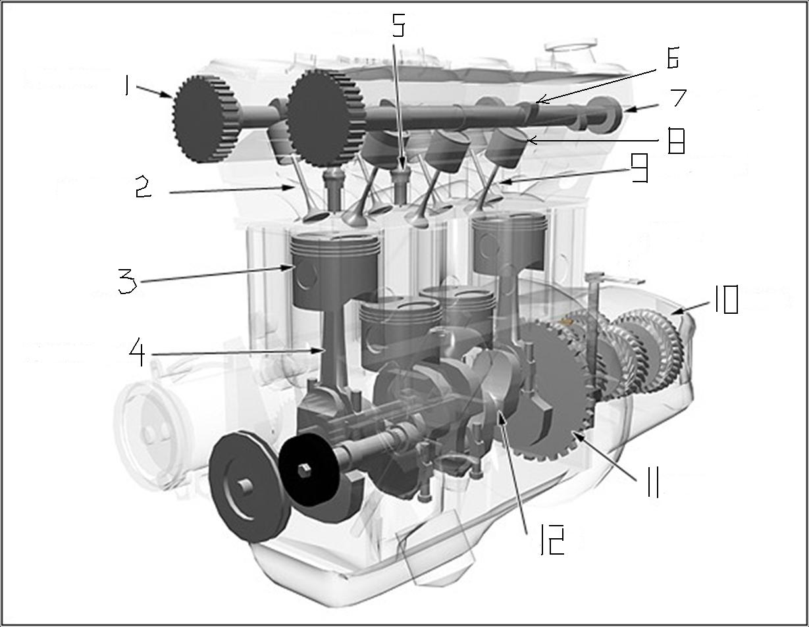
Engines

Slide 24
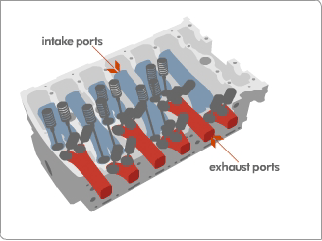
Engine Related Terms
TDC (top dead center)
BDC (bottom dead center)
Stroke
Bore
Revolution
Compression Ratio
Displacement
Cycle

Slide 25
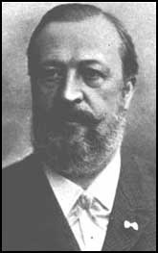
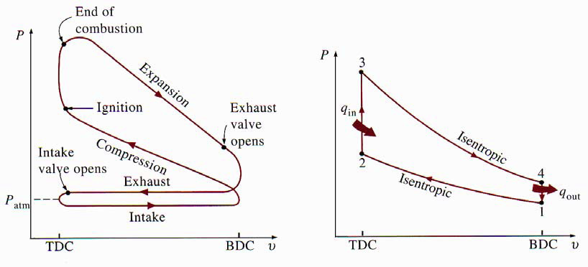
Nikolaus Otto was born in Holzhausen, Germany on 10th June 1832. In his early years he began experimenting with gas engines and completed his first atmospheric engine in 1867. In 1872 he joined with Gottlieb Daimler and Wilhelm Maybach and in 1876 developed the first 4-stroke cycle internal combustion engine based on principles patented in 1862 by Alphonse Beau de Rochas. Although Otto's patent claim for the 'Otto Cycle' was invalidated in 1886, his engineering work led to the first practical use of the 4-stroke cycle which was to provide the driving force for transportation for over a century. Nikolaus Otto died on 26th January 1891.
Four-stroke Otto cycle

Slide 26
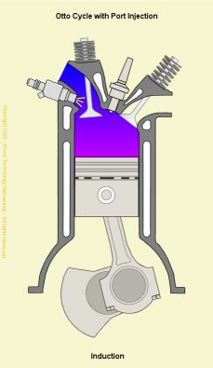
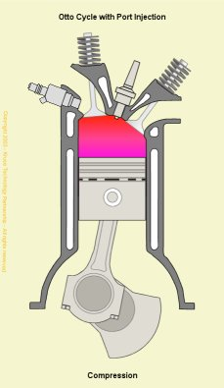
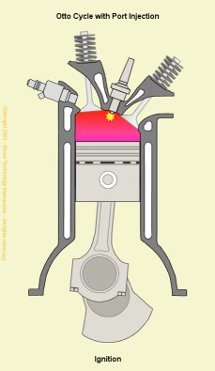
Four-stroke Otto cycle (Port injection/Indirect injection)
Induction Stroke
The induction stroke is generally considered to be the first stroke of the Otto 4-Stroke Cycle. At this point in the cycle, the inlet valve is open and the exhaust valve is closed. As the piston travels down the cylinder, a new charge of fuel/air mixture is drawn through the inlet port into the cylinder.
The adjacent figure shows the engine crankshaft rotating in a clockwise direction. Fuel is injected through a sequentially controlled port injector just behind the inlet valve.
Compression Stroke
The compression stroke begins as the inlet valve closes and the piston is driven upwards in the cylinder bore by the momentum of the crankshaft and flywheel.
Spark Ignition
Spark ignition is the point at which the spark is generated at the sparking plug and is an essential difference between the Otto and Diesel cycles. It may also be considered as the beginning of the power stroke. It is shown here to illustrate that due to flame propagation delays, spark ignition timing commonly takes place 10 degress before TDC during idle and will advance to some 30 or so degrees under normal running conditions.

Slide 27
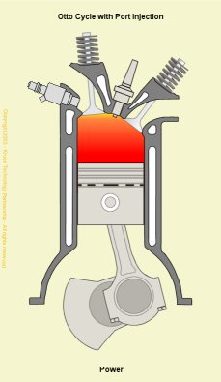
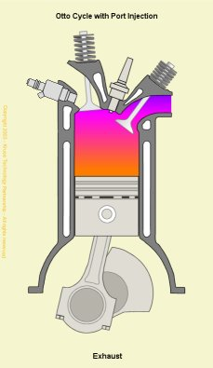
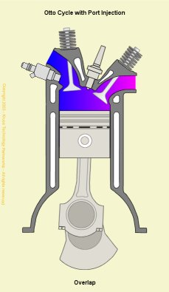
Four-stroke Otto cycle (Port injection/Indirect injection)
Power Stroke
The power stroke begins as the fuel/air mixture is ignited by the spark. The rapidly burning mixture attempting to expand within the cylinder walls, generates a high pressure which forces the piston down the cylinder bore. The linear motion of the piston is converted into rotary motion through the crankshaft. The rotational energy is imparted as momentum to the flywheel which not only provides power for the end use, but also overcomes the work of compression and mechanical losses incurred in the cycle (valve opening and closing, alternator, fuel pump, water pump, etc.).
Exhaust Stroke
The exhaust stroke is as critical to the smooth and efficient operation of the engine as that of induction. As the name suggests, it's the stroke during which the gases formed during combustion are ejected from the cylinder. This needs to be as complete a process as possible, as any remaining gases displace an equivalent volume of the new charge of fuel/air mixture and leads to a reduction in the maximum possible power.
Exhaust and Inlet Valve Overlap
Exhaust and inlet valve overlap is the transition between the exhaust and inlet strokes and is a practical necessity for the efficient running of any internal combustion engine. Given the constraints imposed by the operation of mechanical valves and the inertia of the air in the inlet manifold, it is necessary to begin opening the inlet valve before the piston reaches Top Dead Centre (TDC) on the exhaust stroke. Likewise, in order to effectively remove all of the combustion gases, the exhaust valve remains open until after TDC. Thus, there is a point in each full cycle when both exhaust and inlet valves are open. The number of degrees over which this occurs and the proportional split across TDC is very much dependent on the engine design and the speed at which it operates.

Slide 28
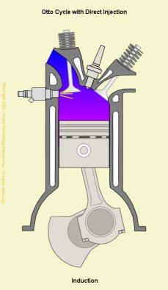
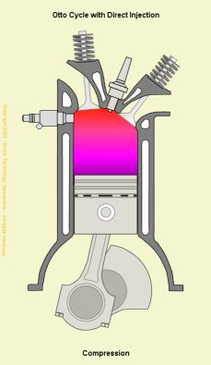
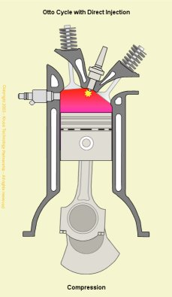
Four-stroke Otto cycle (Direct Injection)
Otto Cycle Operation with Direct Injection
The theoretical Otto Cycle process is the same for both indirect and direct fuel injection methods, but the efficiencies gained by using direct injection are bringing the practical application closer to the theoretical.
Direct injection means that there is a total separation between the air and fuel required for combustion. This allows precise control over the quantity of fuel and the time in the cycle it is introduced into the cylinder. Thus, for maximum power (in similar manner to that of a port injection system), it is possible to inject a full quantity of fuel in the induction stroke, while for low load, maximum economy (lean-burn) operation it is possible to inject a smaller quantity of fuel during the compression stroke.
Although lean-burn is implemented with indirect injection, the lean-burn misfire limit (point at which misfire occurs) is governed by the leanness of the fuel/air mixture in the cylinder. This limit is lowered in direct injection, spark ignition engines, as the fuel spray is directed towards the sparking plug to ensure that there is a chemically adequate mixture around the plug when the spark occurs.

Slide 29
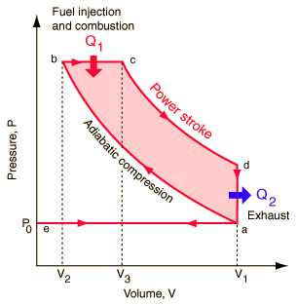
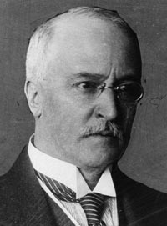
Four-stroke Diesel cycle
Rudolph Diesel was born in Paris of Bavarian parents in 1858. As a budding mechanical engineer at the Technical University in Munich, he became fascinated by the 2nd law of thermodynamics and the maximum efficiency of a Carnot process and attempted to improve the existing thermal engines of the day on the basis of purely theoretical considerations. His first prototype engine was built in 1893, a year after he applied for his initial patent, but it wasn't until the third prototype was built in 1897 that theory was put into practice with the first 'Diesel' engine.

Slide 30
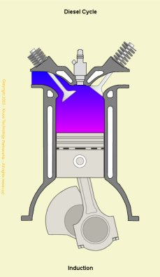
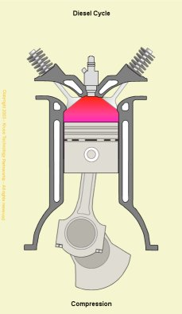
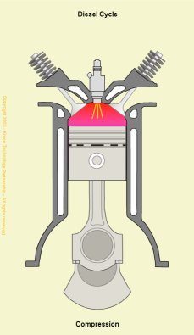
Four-stroke Diesel cycle
Induction Stroke
The induction stroke in a Diesel engine is used to draw in a new volume of charge air into the cylinder. As the power generated in an engine is dependent on the quantity of fuel burnt during combustion and that in turn is determined by the volume of air (oxygen) present, most diesel engines use turbochargers to force air into the cylinder during the induction stroke.
Compression Stroke
The compression stroke begins as the inlet valve closes and the piston is driven upwards in the cylinder bore by the momentum of the crankshaft and flywheel.
The purpose of the compression stroke in a Diesel engine is to raise the temperature of the charge air to the point where fuel injected into the cylinder spontaneously ignites. In this cycle, the separation of fuel from the charge air eliminates problems with auto-ignition and therefore allows Diesel engines to operate at much higher compression ratios than those currently in production with the Otto Cycle.
Compression Ignition
Compression ignition takes place when the fuel from the high pressure fuel injector spontaneously ignites in the cylinder.
In the theoretical cycle, fuel is injected at TDC, but as there is a finite time for the fuel to ignite (ignition lag) in practical engines, fuel is injected into the cylinder before the piston reaches TDC to ensure that maximum power can be achieved. This is synonymous with automatic spark ignition advance used in Otto cycle engines.

Slide 31
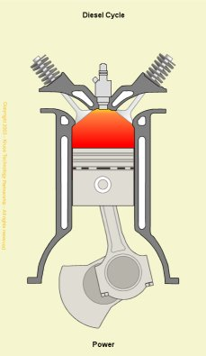
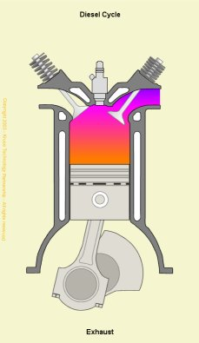
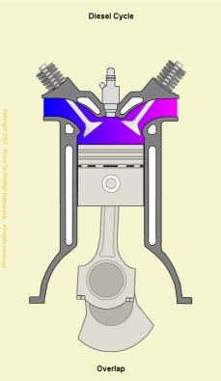
Four-stroke Diesel cycle
Power Stroke
The power stroke begins as the injected fuel spontaneously ignites with the air in the cylinder. As the rapidly burning mixture attempts to expand within the cylinder walls, it generates a high pressure which forces the piston down the cylinder bore. The linear motion of the piston is converted into rotary motion through the crankshaft. The rotational energy is imparted as momentum to the flywheel which not only provides power for the end use, but also overcomes the work of compression and mechanical losses incurred in the cycle (valve opening and closing, alternator, fuel injector pump, water pump, etc.).
Exhaust Stroke
The exhaust stroke is as critical to the smooth and efficient operation of the engine as that of induction. As the name suggests, it's the stroke during which the gases formed during combustion are ejected from the cylinder. This needs to be as complete a process as possible, as any remaining gases displace an equivalent volume of the new charge air and leads to a reduction in the maximum possible power.
Exhaust and Inlet Valve Overlap
Exhaust and inlet valve overlap is the transition between the exhaust and inlet strokes and is a practical necessity for the efficient running of any internal combustion engine. Given the constraints imposed by the operation of mechanical valves and the inertia of the air in the inlet manifold, it is necessary to begin opening the inlet valve before the piston reaches Top Dead Centre (TDC) on the exhaust stroke. Likewise, in order to effectively remove all of the combustion gases, the exhaust valve remains open until after TDC. Thus, there is a point in each full cycle when both exhaust and inlet valves are open. The number of degrees over which this occurs and the proportional split across TDC is very much dependent on the engine design and the speed at which it operates.

Slide 32
Diesel vs Otto engine
Advantages
Higher thermal efficiency as a consequence of a higher compression ratio (16-20 vs 9-12) needed for the self ignition of the mixture
Higher efficiency at part load condition (city driving) because of the different load control with much inferior pumping loss for aspirating air into the cylinder: load control directly by varying the fuel delivery, while in the Otto engine by varying the air through an intake throttle
Less energy spent to produce Diesel fuel
Disadvantages
Higher weight for same power delivery, because of higher thermal and mechanical stresses due to higher temperatures and pressures , almost double vs Otto engine, at the end of compression and combustion phases
Lower maximum engine speed because a slower combustion process and higher weight of the rotating an oscillating masses
Engine roughness that generates higher structural and airborne vibration/noise.

Slide 33
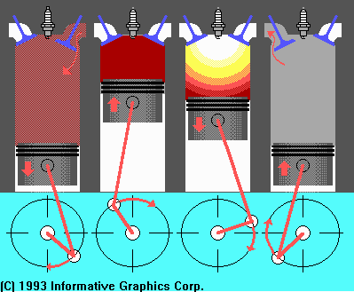
Four Stroke Cycle
Intake
Compression
Power
Exhaust

Slide 34
Internal Combustion Engine Basics
F
Slide 04
D. Abata

Slide 35
Internal Combustion Engine Basics
ignition system
Slide 05
crank mechanism
D. Abata

Slide 36
Internal Combustion Engine Basics
intake system
ignition system
Slide 06
crank mechanism
D. Abata

Slide 37
Internal Combustion Engine Basics
intake system
exhaust system
ignition system
Slide 07
crank mechanism
D. Abata

Slide 38
Internal Combustion Engine Basics
intake system
exhaust system
cooling system
thermostat
ignition system
Slide 08
crank mechanism
D. Abata

Slide 39
Internal Combustion Engine Basics
intake system
exhaust system
cooling system
thermostat
ignition system
lubrication system
Slide 09
crankcase vent
D. Abata

Slide 40
Internal Combustion Engine Basics
fuel
air
air + fuel
pressure
1. Intake Stroke

volume
TDC
BDC
Slide 10
D. Abata

Slide 41
Internal Combustion Engine Basics
pressure
stoichiometric mixture


volume
TDC
BDC
Slide 11
D. Abata

Slide 42
Internal Combustion Engine Basics
pressure

2. Compression Stroke


volume
TDC
BDC
Slide 12
D. Abata

Slide 43
Internal Combustion Engine Basics

pressure



volume
TDC
BDC
Slide 13
D. Abata

Slide 44
Internal Combustion Engine Basics


pressure

3. Power Stroke


volume
TDC
BDC
Slide 14
D. Abata

Slide 45
Internal Combustion Engine Basics


pressure




volume
TDC
BDC
Slide 15
D. Abata

Slide 46
Internal Combustion Engine Basics


4. Exhaust Stroke

pressure




volume
TDC
BDC
Slide 16
D. Abata

Slide 47
Internal Combustion Engine Basics


pressure






volume
TDC
BDC
Slide 17
D. Abata

Slide 48
Internal Combustion Engine Basics
Work =  (pressure x volume)

positive work

1. Intake Stroke

pressure





exhaust gas residual
volume
TDC
BDC
negative work
Slide 18
D. Abata

Slide 49
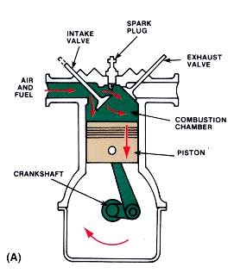
Intake Stroke
Intake valve opens.
Piston moves down, ½ turn of crankshaft.
A vacuum is created in the cylinder.
Atmospheric pressure pushes the air/fuel mixture into the cylinder.

Slide 50
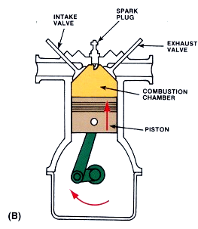
Compression Stroke
Valves close.
Piston moves up, ½ turn of crankshaft.
Air/fuel mixture is compressed.
Fuel starts to vaporize and heat begins to build.

Slide 51
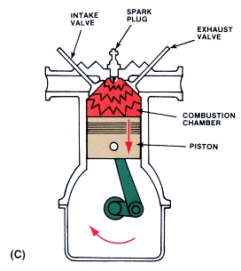
Power Stroke
Valves remain closed.
Spark plug fires igniting fuel mixture.
Piston moves down, ½ turn of crankshaft.
Heat is converted to mechanical energy.

Slide 52
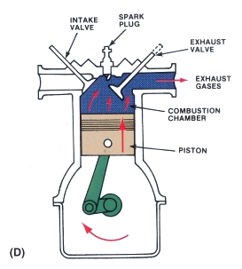
Exhaust Stroke
Exhaust valve opens.
Piston move up, crankshaft makes ½ turn.
Exhaust gases are pushed out polluting the atmosphere.

Slide 53
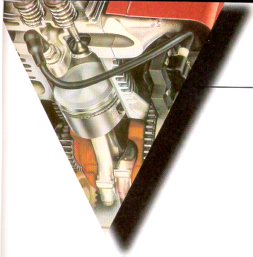

Sequence of Events in a
4-Stroke Cycle Engine
Ch 5

Slide 54

Four stroke diesel cycle

Slide 55

Four Stroke Cycle Animation

Slide 56

Two Stroke Animation

Slide 57
Internal Combustion Engine Basics
1. Intake and Compression Stroke
The Two Stroke Engine
Slide 01
D. Abata

Slide 58
Internal Combustion Engine Basics
The Two Stroke Engine
Slide 02
D. Abata

Slide 59
Internal Combustion Engine Basics
2. Power and Exhaust Stroke
The Two Stroke Engine
Slide 03
D. Abata

Slide 60
Internal Combustion Engine Basics
The Two Stroke Engine
Slide 04
D. Abata

Slide 61
Internal Combustion Engine Basics
The Two Stroke Engine
Slide 05
D. Abata

Slide 62
Internal Combustion Engine Basics
1. Intake and Compression Stroke
The Two Stroke Engine
Slide 06
D. Abata

Slide 63


4-Stroke Engines
intake
exhaust

Slide 64

Diesel Animation

Slide 65

Diesel 2 stroke

Slide 66

Two-stroke cycle
Two-stroke cycle
Gas exchange occurs between the working cycles by scavenging the exhaust gases with a fresh cylinder charge
Control mostly via intake end exhaust ports
In contrast to the four-stroke cycle , no valve train is necessary, but a blower is need for scavenging air

Slide 67

2-StrokeEngines
intake
Reed
Valve
2-stroke

Slide 68
Four stroke vs Two-stroke cycle
Advantages
4-stroke engine
High volumetric efficiency over a wide engine speed range
Low sensitivity to pressure losses in the exhaust system
Effective control of the charging efficiency trough appropriate valve timing and intake system design
2-stroke engine
Very simple and cheap engine design
Low weight
Low manufacturing cost
Better torsional forces pattern
Disadvantages
4-stroke engine
High complexity of the valve control
Reduced power density because the work is generated only every second shaft rotation
2-stroke engine
Higher fuel consumption
Higher HC emissions because of a problematic cylinder scavenging
Lower mean effective pressure because of poorer volumetric efficiency
Higher thermal load because no gas echange stroke
Poor idle because of high residual gas percentage into the cylinder

Slide 69



Sequence of Events in a
2-Stroke Cycle Engine
Ch 5

Slide 70
Two stroke cycle

Slide 71
Advantages & Disadvantages to a 4-Stroke Cycle Engine
Ch 5
    Advantages:
Disadvantages:
High torque output
Smooth running
Quieter operation
Lower emissions output
More forgiving to poor operational practices
Higher horse power availability
Heavier construction
No Gas/Oil mixing
Heavy
Limited slope operation
More moving parts

Slide 72
Advantages & Disadvantages to a 2-Stroke Cycle Engine
Ch 5
    Advantages:
Disadvantages:
Lighter
Can be operated in all positions
Less moving parts
Higher horse power per cc displacement
Low torque output
Erratic running Characteristic
Noisy
Higher emissions output
Gas/Oil mixing

Slide 73
VALVE TIMING DIAGRAM
A valve timing diagram is a graphical representation of the opening and closing of the intake and exhaust valve of the engine, The opening and closing of the valves of the engine depend upon the movement of piston from TDC to BDC, This relation between piston and valves is controlled by setting a graphical representation between these two, which is known as valve timing diagram.

Slide 74
WHY DO WE NEED VALVE TIMING DIAGRAM?
The normal engine completes around 100000 cycles per minute, as we know there are number of processes involve in a single cycle (from the intake of the air-fuel mixture to the exhaust of the combustion residual) of a internal which makes it necessary to be equipped with an effective system that can enable

Slide 75

VALVE TIMING DIAGRAM OF 2 STROKE
PETROL ENGINE

Slide 76

VALVE TIMING DIAGRAM OF 2 STROKE
DIESEL ENGINE

Slide 77

COMBUSTION

Slide 78
Combustion in CI engine
gnition delay - This is the period between fuel injection initiation and beginning of combustion
Premixed or rapid combustion phase - The fuel accumulated in the combustion chamber ignites as the fuel reaches its self ignition temperature. High heat release rate is obtained during this phase.
Mixing controlled combustion phase - The burning rate in this phase is of controlled manner and the heat release decreases in this phase.
Late combustion phase - Heat release rate is lowest in this phase, as small amount of fuel is available for burning.

Slide 79
Combustion in spark ignition engine
The density of unburned mixture ahead of the flame front is as large as four times the density of burned gas which lies behind the flame. 25% of the mass still remains unburnt even if the entire combustion chamber is enflamed. Hence combustion in SI engines can be divided in the following phases-
Spark ignition
Early flame development
Flame propagation
Flame termination

