Slide 1
Compiled by
Veerapandian .K
Mechanical engineering
Vedharanyam

Slide 2
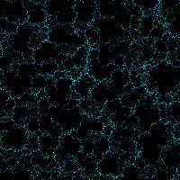
GRAVITATION

Slide 3
FORCES IN THE UNIVERSE

Slide 4
Kinds of Forces
Gravity
Electromagnetism
* magnetism
* electrostatic forces
3. Weak Nuclear Force
4. Strong Nuclear Force
Increasing
Strength

Slide 5
proton
+
electron

Slide 6
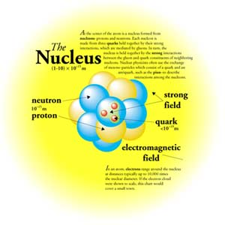
Strong
Force
binds
together
protons &
neutrons
in
atomic
nuclei

Slide 7
proton
+
Weak Force:
Decay of the
Neutron
n
electron

Slide 8
GRAVITATION

Slide 9
GRAVITY keeps the moon orbiting
Earth . . . and Dactyl orbiting Ida . . .
It holds stars
together . . .
And binds galaxies together
for billions of years . . .
Prevents
planets
from losing
their
atmospheres . . .

Slide 10
FALLING BODIES

Slide 11
Falling objects accelerate at a
constant rate (Galileo):
Speed is gained at a constant rate:
9.8 m/sec/sec
Ball
“Acceleration due to gravity”
p. 82
Earth

Slide 12
Acceleration is same for ALL OBJECTS,
regardless of mass!
Speed (m/sec)
Time (sec)

Slide 13
• Newton’s 2nd law ⇒ force (F) is acting on
falling ball (mass = m)
Ball
• All masses have same acceleration
m
. . . so more mass means more force
needed:
F
Earth

Slide 14
• Newton’s 3rd law ⇒ ball pulls on Earth
Ball
F
Does Earth accelerate?
F
Earth

Slide 15
UNIVERSAL GRAVITATION

Slide 16
All bits of matter attract all other bits of matter . . .
M₁
M₂
F
F
d
“Inverse square law”
p. 92

Slide 17
1. ⇒ Increase one or both masses, and force increases.
2. ⇒ Force decreases as distance increases.
M₁
M₂
F
F
d
Force | Distance
400 N | 10 m
100 N | 20 m
25 N | 40 m
16 N | 50 m
4 N | 100 m

Slide 18
Force never becomes
zero.
Force
Distance

Slide 19
Putting the two parts of the force law together . . .
(G = gravitational constant)
Acts through empty space
“action at a distance”
• Explains how gravity behaves – but not why

Slide 20
WEIGHT

Slide 21
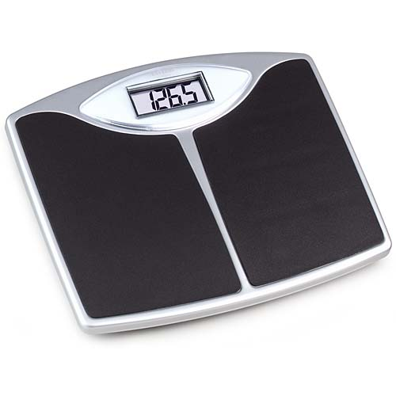
p. 83

Slide 22
Weight
• Measure of gravitational attraction of Earth
(or any other planet) for you.
m
M
F
Weight
R
Earth

Slide 23
Other planets: M and R change, so your
weight must change
A real planet . . .
Mars: R = 0.53 x Earth’s radius
M = 0.11 x Earth’s mass
Earth Mars
Weight 150 lbs 59 lbs

Slide 24
“Weight” can be
made to apparently
increase . . .
upward acceleration
p. 83

Slide 25
. . . or decrease!
9.8 m/s/s
Free-fall
downward
acceleration
“Weightlessness”

Slide 26
EARTH’S MASS

Slide 27
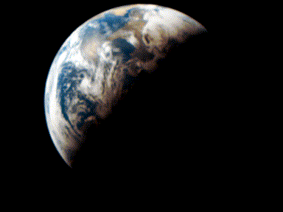
Earth’s mass
your mass
your weight
Earth’s radius
M = 6 x 10²⁴ kg

Slide 28
HOW DO THE PLANETS GO?

Slide 29
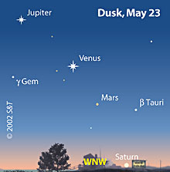
Planets appear
‘star-like’

Slide 30
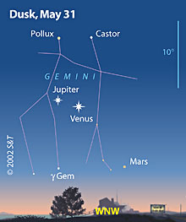
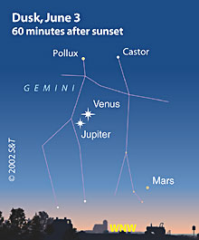
Planets move, relative to the stars.

Slide 31
Planets reside
near Ecliptic.

Slide 32
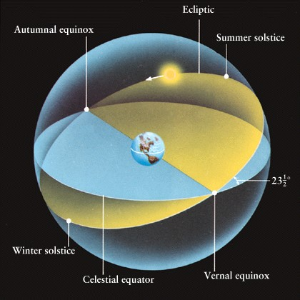

Slide 33
[SkyGlobe]

Slide 34
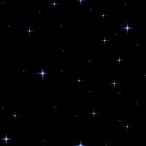
Alien’s eye view . . .
Venus
Sun
Earth
Mars
Complicated!

Slide 35
Yet, patterns may be discerned . . .
Planets remain near ecliptic – within Zodiac.
Brightness changes in a regular pattern.
Mercury & Venus always appear near Sun in sky.
Mars, Jupiter & Saturn may be near Sun, but needn’t be.
Planets travel eastward relative to stars most of the time,
but sometimes they reverse direction & go west!
Ack!

Slide 36
Jupiter & Venus
are currently
“in”
Gemini.

Slide 37
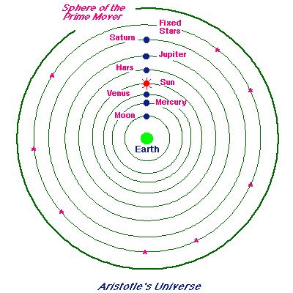
Ancient
Greek
geocentric
solar
system

Slide 38
Motionless Earth
* Earth too heavy to be moved
* If Earth moved, wouldn’t we notice?
> Relative motion argument
> Parallax argument
Earth at center of Universe
* This is Earth’s ‘natural place’
> Heavy stuff sinks
* This is the natural place of humankind
> We’re most important (?)

Slide 39
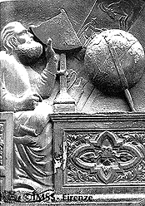
Ptolemy
(85 – 165 AD)

Slide 41
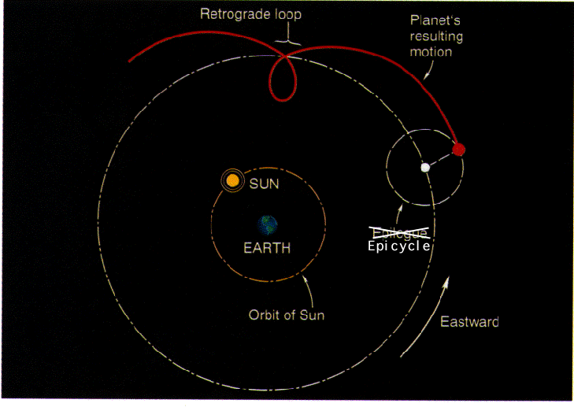
Results: • Planet-Earth distance changes
• Planet sometimes goes backward

Slide 42
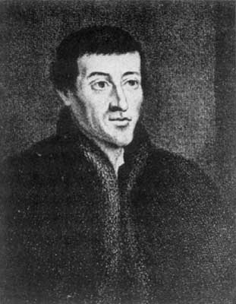
Nicolaus Copernicus (1473 – 1543)
First modern heliocentric (sun-centered) model of solar system
Founder of modern astronomy
Not first astronomer!

Slide 43
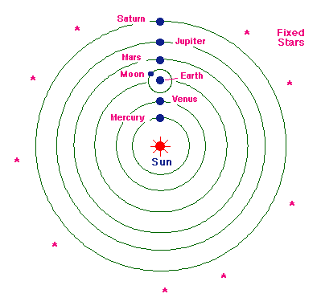
Copernicus’
heliocentric
model,
simplified

Slide 44
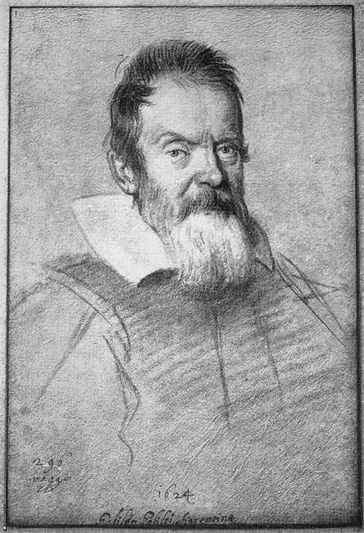
Galileo Galilei
1564 - 1642

Slide 45
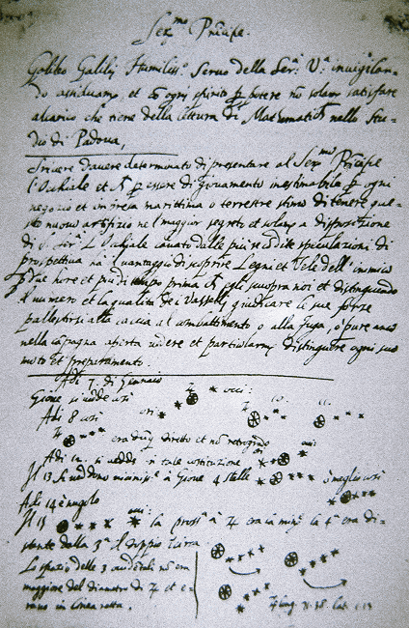
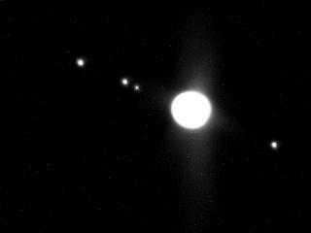
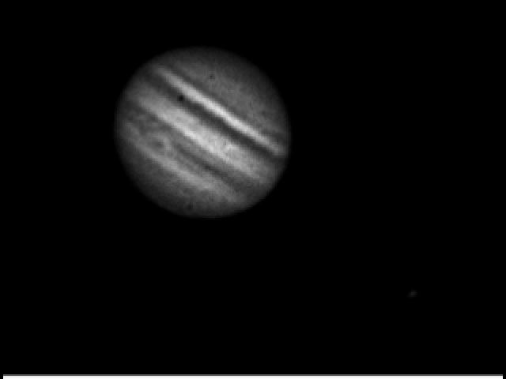
Galileo observes
Jupiter’s
four largest moons
Telescopic
View

Slide 46
Allowed
possibility
that there
are many
centers of
motion –
not just Earth.
Jupiter’s moons
in motion.

Slide 47
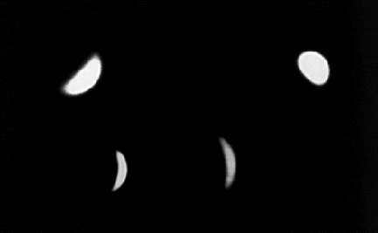
Venus shows a full set of phases –
like the moon’s

Slide 48
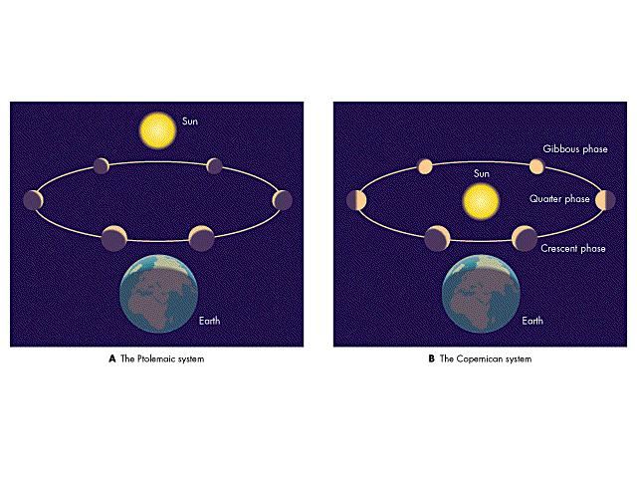
Venus’ motion according to . . .
Ptolemy
(new & crescent phases)
Copernicus
(full set of phases)

Slide 49
ORBITS

Slide 50
NEWTON: Gravity explains how planets (and
moons & satellites & etc.) go.
• Any motion controlled only by gravity is an orbit
Without gravity
With gravity
Sun

Slide 51
Several trajectories are possible. . .
Circle
F
Object is effectively
continuously falling
toward the sun . . .
. . . But never gets
there!

Slide 52
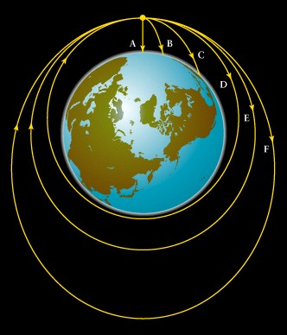
Imagine launching a
ball sideways near
Earth . . .

Slide 53
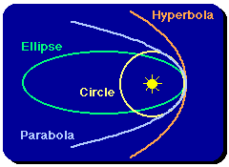
Possible trajectories:
“Escape”
• Circle
• Ellipse
• Parabola
• Hyperbola
v
Which one you get depends on speed (v)!

Slide 54
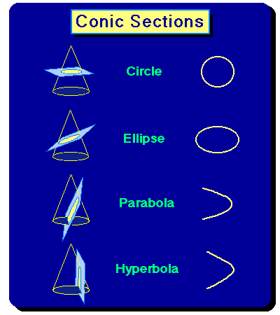
Trajectories are
conics
These are only
possible orbits for
inverse square
law force.

Slide 55
• Circles & Ellipses: “Bound” orbits
• Parabolas & Hyperbolas: “Escape” orbits
v > 5 mi/sec
Escape:
v ≥ 7 mi/sec
v
v ≅ 5 mi/sec
Earth

Slide 56
KEPLER’S LAWS

Slide 57
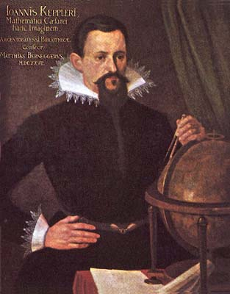
Johannes
Kepler
(1571 – 1630)

Slide 58
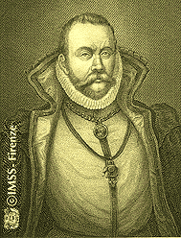
“By the study of the orbit of Mars, we must either
arrive at the secrets of astronomy or forever remain
in ignorance of them.”
- J. Kepler
Tycho Brahe

Slide 59
1. Planets move in elliptical orbits with the sun at one focus
Sun (Focus)
c
X
Focus
Semi-major axis (a)

Slide 60
67,000 mi/hr
Aphelion
Perihelion
Earth: a = 1.00 AU = 92, 980.000 mi
aphelion = 1.0167 AU = 94,530,000 mi
perihelion = 0.9833 AU = 91,420,000 mi

Slide 61
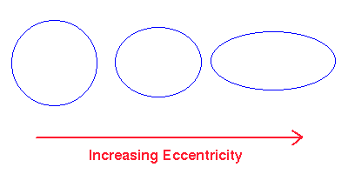
Eccentricity (e): Measure of shape of ellipse
e = c/a a = semi-major axis
c = dist center to focus
0 < e < 1

Slide 62
A few objects orbiting the sun . . . . . .
a e
Earth 1.0 AU 0.0167
Mars 1.52 0.0934
Pluto 39.5 0.250
Halley’s Comet 17.8 0.967
Semi-major axis, or mean distance
between planet & sun

Slide 63
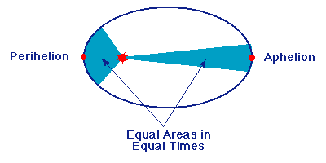
2. A line drawn from planet to sun sweeps out
equal areas in equal times
2nd Law
Demo

Slide 64
3. The cube of the mean planet-sun distance is
directly proportional to the square of the
planet’s orbit period
a³ = P² a: AU
P: years
Or,
a³/ P² = 1
3rd Law
Demo

Slide 65
Solar System:

Slide 66
Newton modified Kepler’s 3rd Law:
m
M
units of the
Sun’s mass

Slide 67
SUN’S MASS

Slide 68
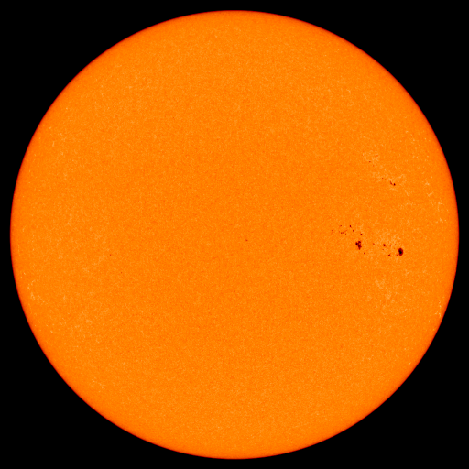
Mass of the Sun
1 AU
1 yr
Sun’s Mass
Earth’s mass
M = 2 x 10³⁰ kg ≅ 330,000 Earth masses (!)

Slide 69
CENTER OF MASS ORBITS

Slide 70
Finally (at last ☺) . . . the true story of orbits
We left something out . . .
Yikes!
Planet
Sun
Sun pulls on planet . . . planet pulls on sun
⇒ Sun moves a little, too!

Slide 71
Exaggerated view:
Circular orbits
X = center of
both orbits
S
X
P

Slide 72
Consider Jupiter & the Sun . . .
Center of Mass
X
0.0052 AU
5.2 AU
⇒ Sun’s motion is small!
Gravitational
Orbits
Animation

Slide 73
Earth & Moon:
X
2900 mi
235,500 mi
2900 mi < Earth’s radius!
Gravitational
Orbits
Animation

Slide 74
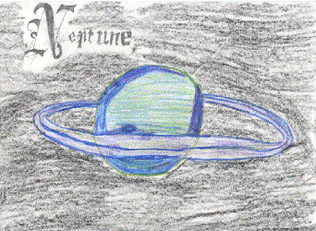
Discovery of Neptune
1846: Presence of Neptune predicted
from irregularities in Uranus’ orbit.
(J. C. Adams & U. J. J. Leverrier)

Slide 75
Neptune
Uranus
Speeds up
Slows down

Slide 76
pandian
        Yours lovingly
VEERAPANDIAN.K

